Slide 1
Body Fat Prediction

Slide 2
Background of the problem
The body fat percentage (BFP) of a human or other living being is the total mass of fat divided by total body mass, multiplied by 100; body fat includes essential body fat and storage body fat.
Essential is necessary to maintain life and reproductive functions. The body fat percentage is a measure of fitness level, since it is the only body measurement which directly calculates a person's relative body composition without regard to height or weight.
The widely used body mass index (BMI) provides a measure that allows the comparison of the adiposity of individuals of different heights and weights. While BMI largely increases as adiposity increases, due to differences in body composition, other indicators of body fat give more accurate results; for example, individuals with greater muscle mass or larger bones will have higher BMIs. As such, BMI is a useful indicator of overall fitness for a large group of people, but a poor tool for determining the health of an individual.

Slide 3
Proposal
Using Machine learning algorithms, we will predict if body fat of a person.
Train the data with 80% of the dataset and test with the remaining 20% of the dataset.
Process Overview
Preliminary analysis on data
Data preparation and cleaning
Exploratory Data Analysis
Train and test models
Model evaluation and tuning

Slide 4
Data Understanding
The dataset that is selected has the measurements of body like wrist, height, weight age etc.
It is a very small dataset with 250 records.

Slide 5
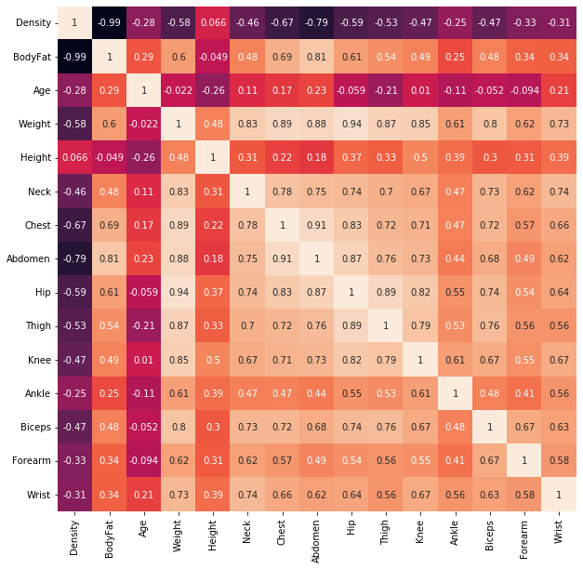
Exploratory Data Analysis
The matrix is used to find the correlation between all the possible pairs of values in the dataset.
In this matrix, density is strongly related with Bodyfat.
Abdomen is positively correlating with any variables.

Slide 6
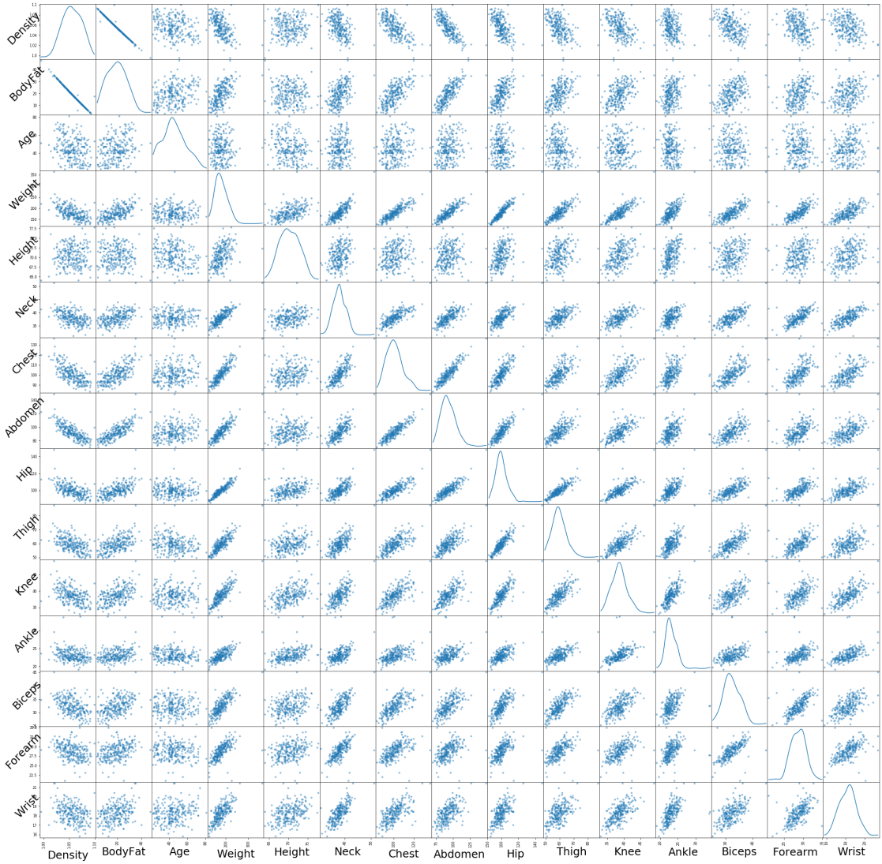
Scatterplot Relation of Variables
Most of the features are linearly dependent to the target variable bodyFat

Slide 7
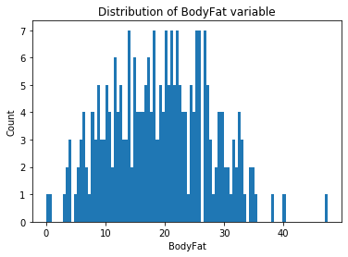
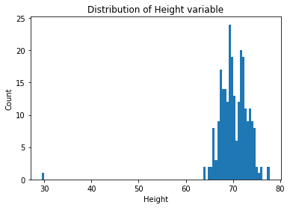
Handling Outliers
When we plot the BodyFat and Height histograms, we can visually identify the outliers and remove them for the dataset

Slide 8
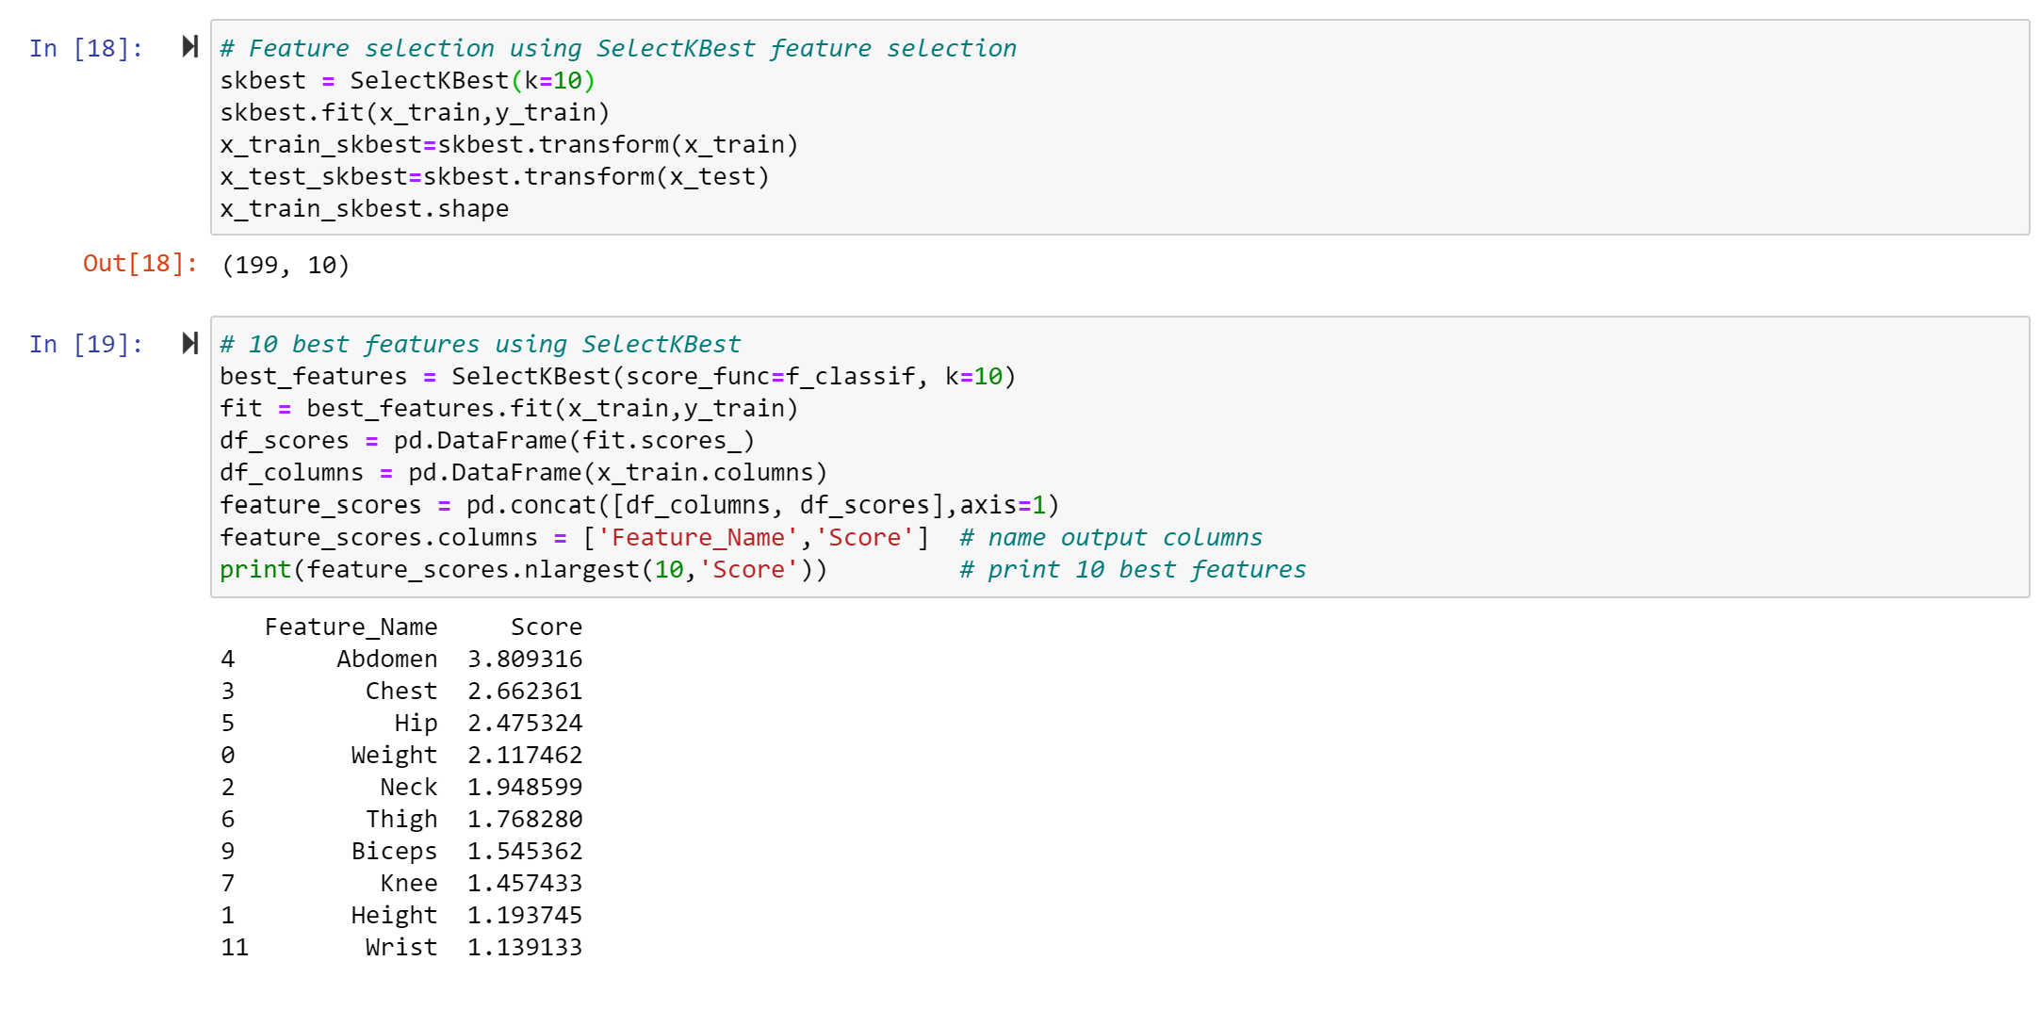
Best Features to Predict Target Variable

Slide 9
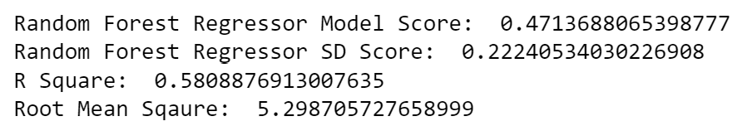
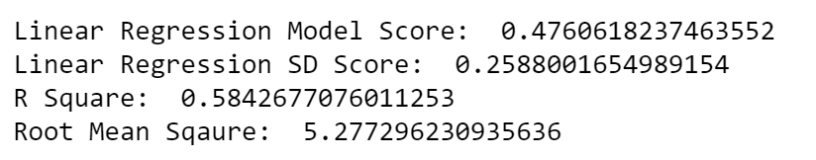
Model Selection
Based on a high model score value, between Random Forest Model and Linear Regression Model we are using Linear Model to provides us high true prediction values for our dataset.

Slide 10
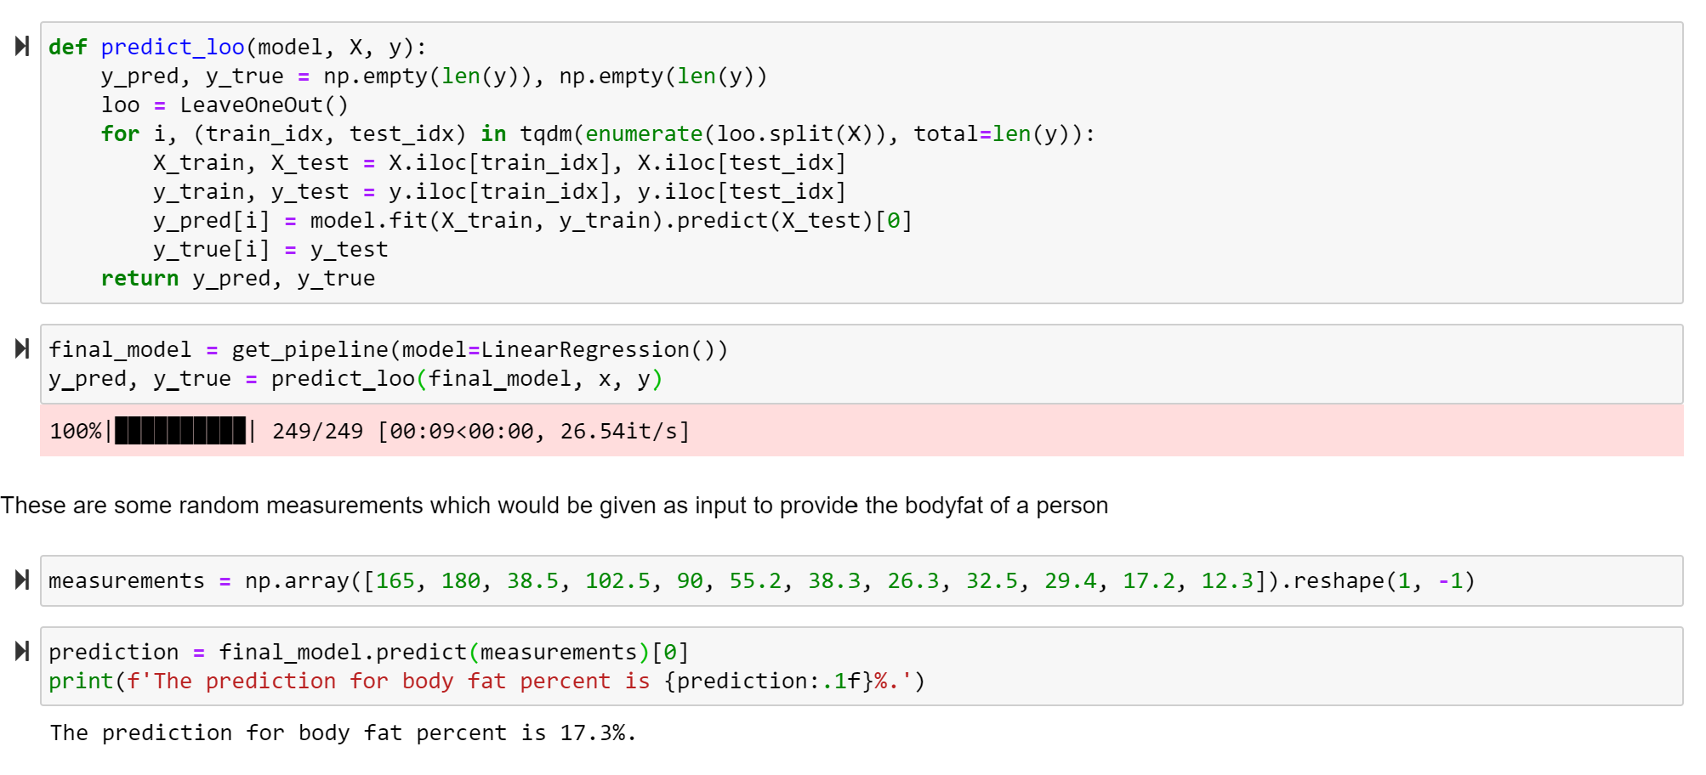
BodyFat Prediction with New Data

Slide 11
Conclusion
Age do not have any influence on the prediction of Body Fat.
Based on a comparison of the Regression models, we recommend that Linear Regression model would be a better performing model to predict the Body Fat.
Based on the BodyFat, we can tell whether the person is Obese or not

Slide 12
Reference
Kaggle link for a dataset: https://www.kaggle.com/fedesoriano/body-fat-prediction-dataset
https://www.niddk.nih.gov/health-information/weight-management/adult-overweight-obesity/definition-facts
https://en.wikipedia.org/wiki/Body_fat_percentage#:~:text=The%20body%20fat%20percentage%20(BFP,maintain%20life%20and%20reproductive%20functions.
https://www.scribbr.com/methodology/research-ethics/

